Slide 1
Pest control of aphids depends on landscape complexity and natural enemy interactions Final group project
Mikiko
Ebun
Adriele Benedetto
Francisco Martinez

Slide 2
Introduction Why is this article relevant?
Aphids are a major pest concern. Biological control is an overlooked tool in aphid control.
Study attempts to fill a knowledge gap: the specific contribution of different natural enemy guilds (NEG) in controlling aphids across a gradient in landscape complexity.
To isolate the effects of different NEG, enclosures were used on 18 fields of Brassica oleraceae with varying degrees of landscape complexity.
Assumption: natural complexity → density and diversity of NEG → aphid population → cabbage biomass

Slide 3
A wide array of variables
Variables can be divided into:
Independent variables
Landscape complexity
Exclusion treatment ( = different combinations of NEG)
Many others
Dependent variables
Aphid density
Aphid population growth (APG) (calculated)
# of parasitized aphids
Parasitism rate (calculated) [the proportion of parasitized aphids over total aphids]
# of syrphid larvae
Syrphid fraction (calculated) [the number of syrphid larvae / (counted aphids + syrphid larvae)
Cabbage biomass, the ultimate dependent variable that farmers care about

Slide 4
Our objectives
Mainly, we wanted to determine:
The effect of natural enemies (NE) on APG across a gradient of landscape complexity (LC).
Since APG is likely to be affected by parasitism and syrphids, we assessed:
2. The effect of NE on parasitism rate and syrphid fraction across a gradient of LC.
The individual and combined effect of NE on APG, syrphid fraction and parasitism would examined.
3. The possible interaction between NE and LC. Interaction would imply that the effects of NE guilds are affected by the complexity of the landscape.

Slide 5
Many research questions and hypothesis..
Does the presence of natural enemies (NE) decrease aphid population growth?
Is the effect of NE complementary or antagonist on the dependent variables (e.g. APG, parasitism rate, syrphid fraction)?
Is there a difference in the effect of NE between complex and simple landscapes?
Is there an interaction between the efficiency of NE and landscape complexity (LC)?
Do parasitism and syrphid presence increase with greater landscape complexity?
Does aphid population growth decrease cabbage biomass?

Slide 6
Method What did we do on R?
We created 3 new variables whose formulas were given: APG, parasitism rate and syrphid fraction.
We created an excel sheet listing all the relationships between the variables that are relevant to assess.
We plotted the major relationships to outline trends and study the relationships between key variables.
We ran a significant amount of linear models (lm) to know what model fits best for 6 dependent variables (only 3 in the original study): aphids density, APG, aphids parasitized, parasitism rate, syrphid fraction and biomass.
We carried out ANOVAS followed by “post hoc” tests to highlight significant differences between the models.

Slide 7
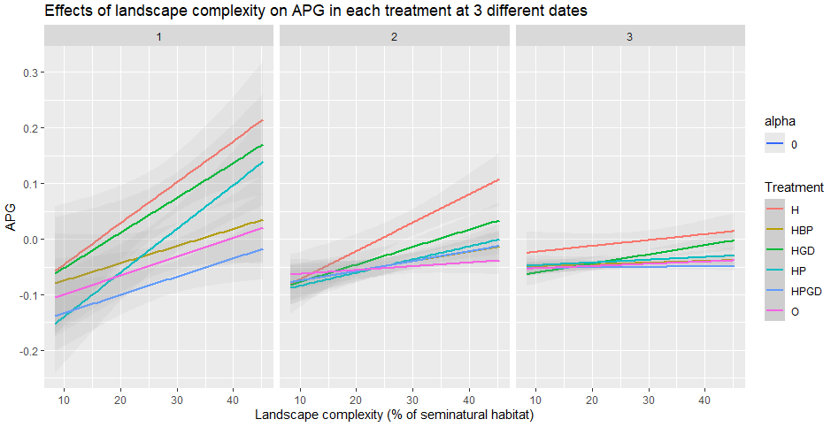
Effects of NE and landscape complexity on APG
Legend:
H = herbivores only (all enemies excluded)
GD = ground-dwellers
P = flying insects
B = birds
O = all enemies.
Notes:
If we compare the 3 dates, we observe that the APG slope flattens, gets less steep over time.
In all treatments and for all dates (except the last one when it is less clear), we see a trend highlighting an increase in APG as landscape complexity increases.
It can also be seen that in treatments involving more than 2 natural enemies, APG growth was the lowest. For example, the dark blue line represents the treatment with herbivores, flying insects and ground-dwellers while the pink one stands for all enemies. These two colors lie below the other ones, APG growth was most reduced in these treatments. On the other hand, when all natural enemies are excluded (H treatment), APG growth is at its highest.
This finding is consistent with our hypothesis.

Slide 8
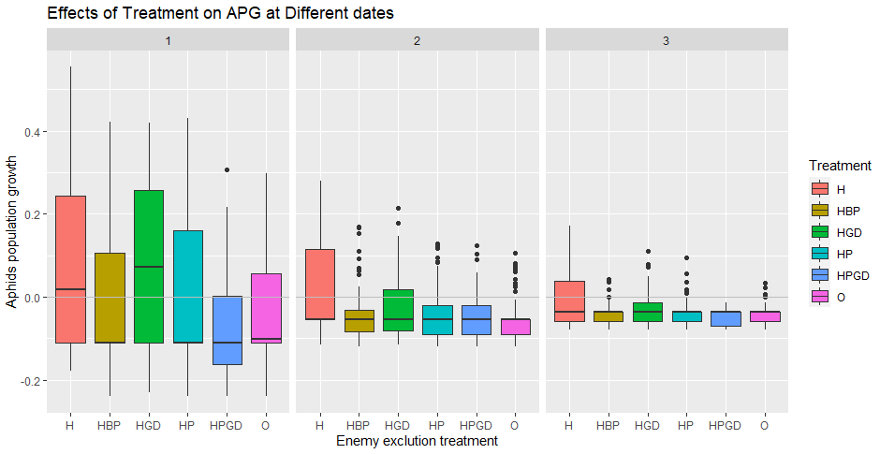
Effect of enemy exclusion treatments (= combination of NE guilds) on APG at Date 1, 2 and 3

Slide 9
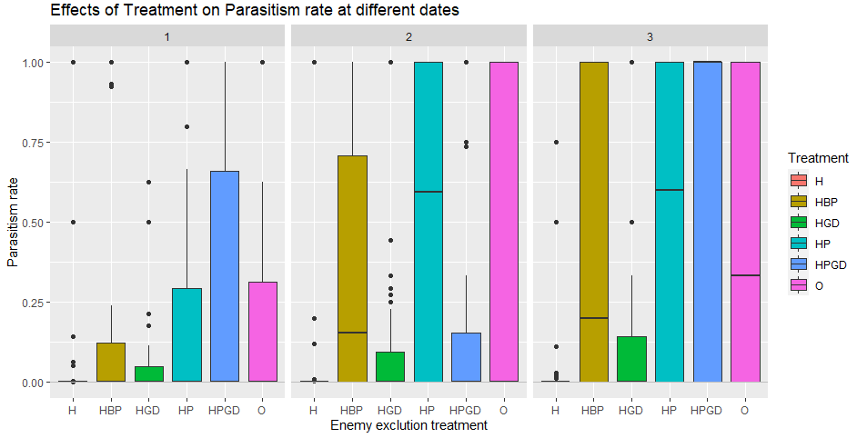
Effect of enemy exclusion treatments on parasitism rate at Date 1, 2 and 3

Slide 10
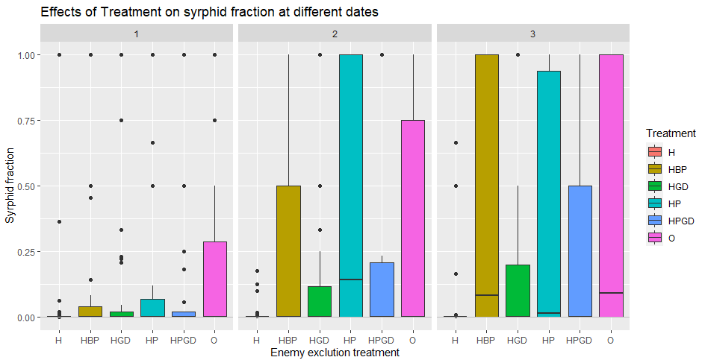
Effect of enemy exclusion treatments on syrphid fraction at Date 1, 2 and 3
Note: All NaN values have been removed.

